Slide 1
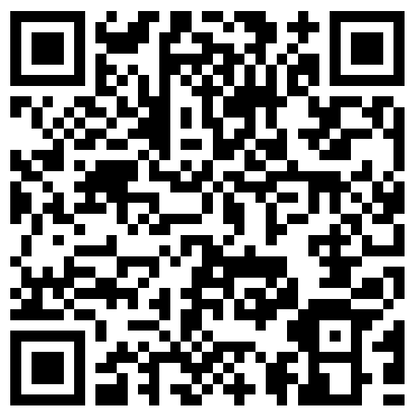
Please check in to this event to register your attendance
CV for internships and part-time work
5 October, 11:00 am
To check in:
scan the QR code with your phone
sign in to your CareerHub account
click on ‘Check-in’ at the bottom of your screen
Email careers@lse.ac.uk if you experience issues checking in.

Slide 2
CVs for internships and part-time work
Barnaby Mollett, LSE Careers

Slide 3
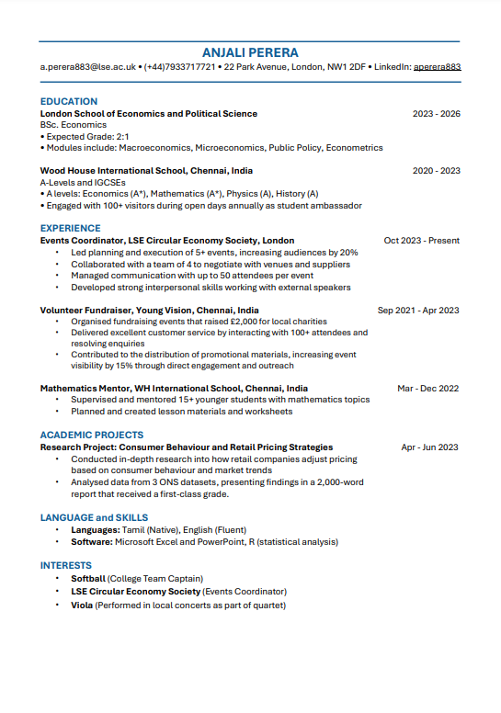
This session…
Understand the essential components of a CV
Communicate effectively what you can offer as an intern
Identify what employers are looking for in internship and part-time work candidates
Resources
Notes:
For webinars – on career skills

Slide 4


Quick poll: How long do recruiters look at CVs?
A. 1 minute
B. 30 seconds
C. 7 seconds
Source - http://go.theladders.com/rs/539-NBG-120/images/EyeTracking-Study.pdf

Slide 5
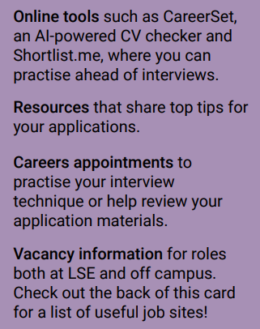
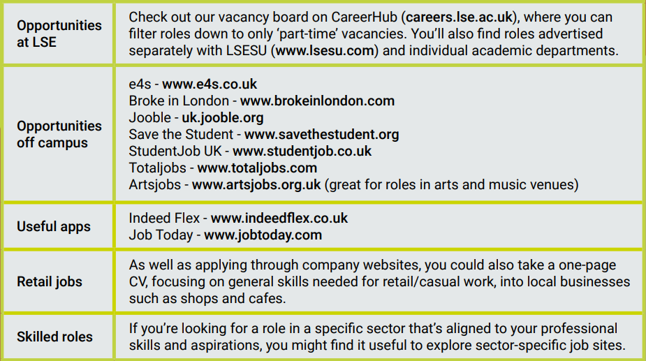
Looking for part-time work?

Slide 6
What is the employer looking for?
Highlight the knowledge, skills and abilities
Use your CV to respond to these with examples of relevant experience
Highlight the company’s mission and vision
Think about how you can you reflect their objectives in your CV

Slide 7
Part-time job description
Part-Time Office Admin Assistant (12 hours per week)
We are seeking a dynamic and enthusiastic student to join our team as a Part-Time Office Admin Assistant. In this role, you will be expected to communicate through emails, written documents and in meetings, working effectively as part of a team and work with colleagues across different divisions. You will thrive in a fast-paced office environment, with our values of positive energy, dedication and supporting each other underpinning our work. Responsibilities
Assist with daily administrative tasks, including filing, data entry, and managing correspondence.
Support team members with scheduling meetings, preparing documents, and coordinating events.
Handle incoming calls and emails, providing excellent customer service and directing inquiries to the appropriate person.
Skills Requirements
Strong communication and presentation skills, both written and verbal.
Ability to work effectively as part of a team and build positive interpersonal relationships.
Excellent organisational skills and attention to detail, able to manage multiple tasks in a fast-paced environment.
Punctuality and reliability, with a strong sense of responsibility and dedication to maintaining high standards.

Slide 8
Internship job description
Communications Summer Internship Program, MO Minerals
Our Internship Program is an opportunity for you to shape MO Minerals from the inside out. We want you to be part of our team to help take us forward by solving the emerging challenges of our time. At MO Minerals, we believe the best ideas come from bringing together different perspectives to work toward a common goal - to create a better tomorrow. Duties
Reporting to the Principal Advisor, social media and working within the Communication organizations, you will :
Draft various types of communications and develop simple communications plans
Contribute communications data gathering and tracking
Provide event co-ordination and support (e.g. town halls, employee celebrations)
Prepare communications reports in Canva and other reporting tools
What you’ll bring
Ability to multitask and coordinate competing tasks
Confident in the use of communications-related software and tools (Canva experience an advantage)
Clear communicator with exceptional interpersonal, communication and presentation skills
Ability to work independently as well as an effective team member
Able to build a strong rapport with internal and external stakeholders
An understanding of or interest in the work of MO Minerals

Slide 9

‘Transferable’ skills
Planning
Interpersonal skills
Problem solving
Adaptability
Communication
Research
Teamwork
Innovation
Utilise job descriptions for your area and/or Harvard Competency Dictionary

Slide 10
The basics
Maximum 2 sides of A4 (unless it’s an academic position)
Don’t write in the first person (“I did this”, “I was responsible for..”, etc.)
Each section in reverse chronological order
Efficient layout
Avoid large chunks of unbroken text
Use bullet points and line spaces to break it up
Even spacing – don’t cram information in
Bold characters are clearer than underlining
Avoid elaborate fonts
Check spelling!

Slide 11
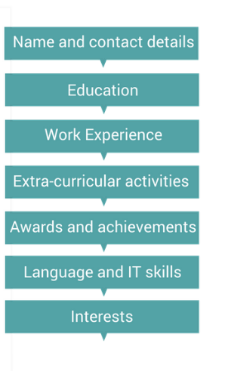



What to include in your CV
  
Headings are up to you – tailor them to the employer and the job.
Create a master CV documenting all your experience in detail to reference.

Slide 12
Some points on layout
No photo (for UK)​
Could include LinkedIn in profile​
Plain white background​
Consistent vertical alignment & clear section breaks​
Limited number of font variations (size, italics, caps)​
Included position, company, dates​
Bullet points with specific examples​
- Start with action verb​
- Description​
- Result/outcome (if possible)

Slide 13
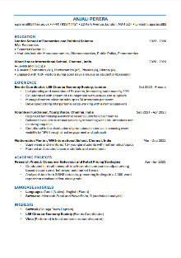
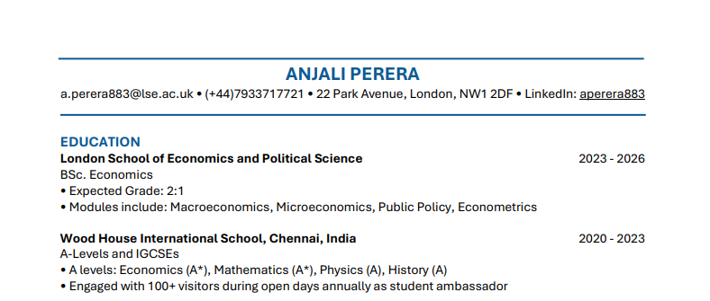
Example (1/3)
Notes:
Continued on next slide

Slide 14
Education
Reverse chronological order
Education institution name/dates
Your qualification(s) & grades
Relevant modules
Summary of dissertation or major project
Awards and scholarships
Upper secondary schooling (earliest required)

Slide 15
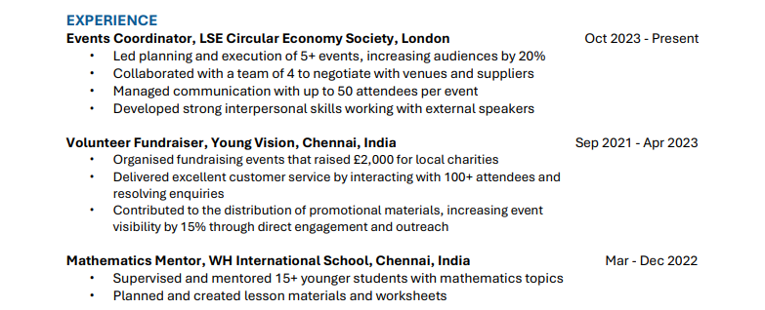
Example (2/3)
Notes:
Continued on next slide

Slide 16
Your work experience
Paid work experience
Unpaid work experience
Research positions
Internships
Volunteering
Military service
Extra-curricular activities (e.g. sport, clubs or societies)
Class representative (especially if elected)
Competitions, awards, etc.
Anything that gave you skills and experience relevant to the position

Slide 17
Writing for impact
Level 4: Organised a green business meetup event establishing 30+ partnership with local organisations
4
3
2
1
Level 3: Engaged with local business to organise…
Level 2: Supported the organisation of an event…
Level 1: I had duties including organising events…

Slide 18
Action verbs
Achievement
Communication
Taking initiative
Research
Organising & planning
Teamwork / Interpersonal
accelerated, accomplished, achieved, carried out, completed, improved, delivered, enhanced, negotiated, obtained, produced, secured, increased, implemented
advised, participated, chaired, wrote, instructed, demonstrated, edited, presented, discussed, promoted, persuaded, recommended, authored, drafted, reviewed
created, conducted, developed, formulated, designed, established, introduced, devised, started, set up, launched, initiated, enabled, performed, managed, restricted, executed, planned, expanded, devised, benchmarked, led, executed, brainstormed, generated
classified, differentiated, investigated, determined, experimented, equated, searched, developed, surveyed, examined, indexed, compiled, catalogued, analysed
distributed, reorganised, arranged, restructured, budgeted, verified, scheduled, computed, planned, produced
advised, collaborated, negotiated, consulted, evaluated, proposed, handled, discussed, mediated, facilitated, supervised, forged, led, facilitated, supported, mentored, corresponded, coached, formed

Slide 19
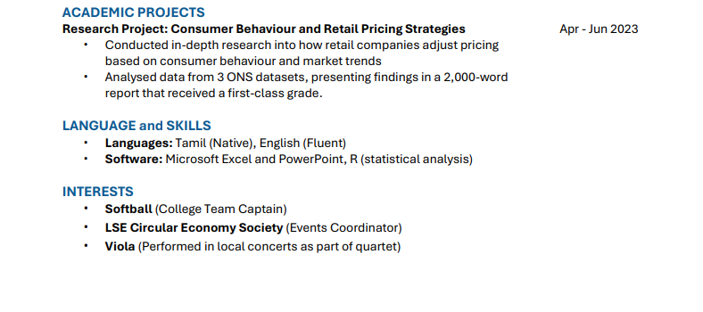
Example (3/3)
Notes:
Continued on next slide

Slide 20
Technical skills
IT skills
Give contextual examples of your IT skills that are relevant to the position e.g. Proficient in Excel; carried out regression analysis to determine performance of a fund against the FTSE 100
Think about the tools you have used during your degree (MatLab, Stata, R, SPSS) or internship (Excel, Tableau, social media monitoring)
Don’t exaggerate your proficiency – graduates can get caught out!
Language skills
Native, fluent, intermediate, basic, conversational (mention if you have qualifications)
Think also of: economic modelling, use of sector-specific database, CRM…

Slide 21
Interests
Any other interests or activities that don’t fit under the other headings
Avoid simplistic lists that don’t add much e.g. reading, cooking, current affairs
Highlight level of involvement/achievements:
Reading: Particularly contemporary literature, member of a book group and chair meetings when required
Swimming: Member of university team, train three times per week and regularly compete in competitions
Running: Member of North London Running Club and completed the London Marathon in 2021
Present in themes if you have a lot – Sports, Music, Committee work
Can come up at interview, don’t put things in for the sake of it!

Slide 22
Other possibilities
Personal profile
Be careful of generic statements that don’t represent you or relate to the job; be factual and highlight your key assets
Different styles of CV
Choose a layout that fits your information. Could use:
Skills-based – no experience or career changing
Creative – be certain it’s appropriate
International – check for differences

Slide 23
Resources
A guide to CVs, cover letters and application forms
LSE Careers website: CVs (includes student examples)
Book at 1to1 appointment with a Careers Consultant through CareerHub
CareerSet: AI-driven tool to get feedback on your CV and cover letter
LSE Careers website: Part-time work

Slide 24
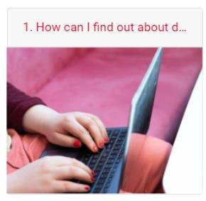
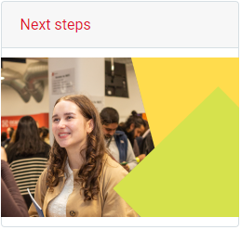
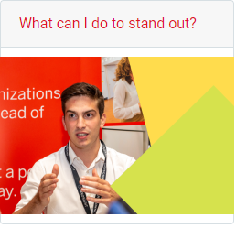
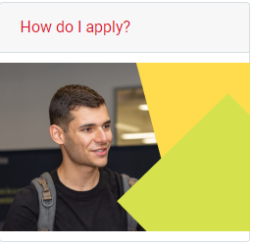
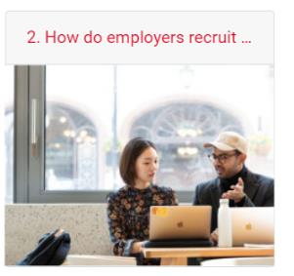

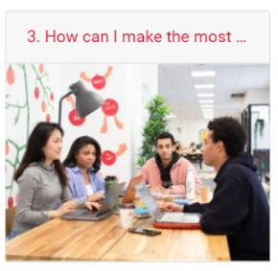
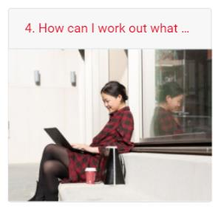
STEP into LSE Careers
Careers Moodle Courses
Understanding Careers: How can I make the most of my time as an LSE undergraduate
An online careers course for Master's students
Supporting you to Think, Explore, and Plan for your career
Access the course via Moodle at
https://moodle.lse.ac.uk/course/view.php?id=9235
An online careers course for LSE undergraduates, empowering you to discover, explore, and shape your career path Access the course via Moodle at
https://moodle.lse.ac.uk/course/view.php?id=9029
Notes:
Designed for incoming master’s students, particularly those who are unfamiliar with the UK’s job market and early recruitment cycles, STEP explores careers topics ranging from making the most of the master’s year to making job applications the best they can be. Hosted on Moodle, the course features short presentations, written content, videos, activities, and links to existing resources. STEP will be accessible to students once they’ve completed registration and have an LSE login.

Slide 25

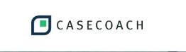




Online tools available to all LSE students
Review your CV with CareerSet
Prepare for case interviews with CaseCoach
Support for international students with Student Circus
Practise interviews with Shortlist.me
Practise psychometric tests with Graduates First
Get answers to your career question using Ask an Alum
Browse all online tools: bit.ly/lse-careers-online-tools

Slide 26
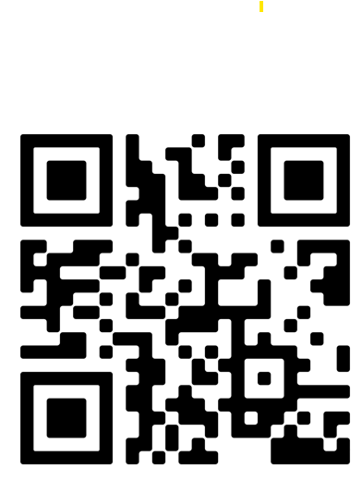
Please share your feedback with us
Applications Day
To give feedback:
scan the QR code with your phone
sign in to your CareerHub account
3. complete the form and click submit Email careers@lse.ac.uk if you experience any issues with the feedback form.

